Slide 1
The unit circle
Trigonometry

Slide 2
How our teaching resources are designed for the classroom

Slide 3
I can appreciate that the trigonometric functions are derived from measurements within a unit circle.

Slide 4
The radius is any line segment that joins the centre of a circle to any part on its circumference.
The hypotenuse is the side of a right-angle triangle which is opposite the right angle.

Slide 5
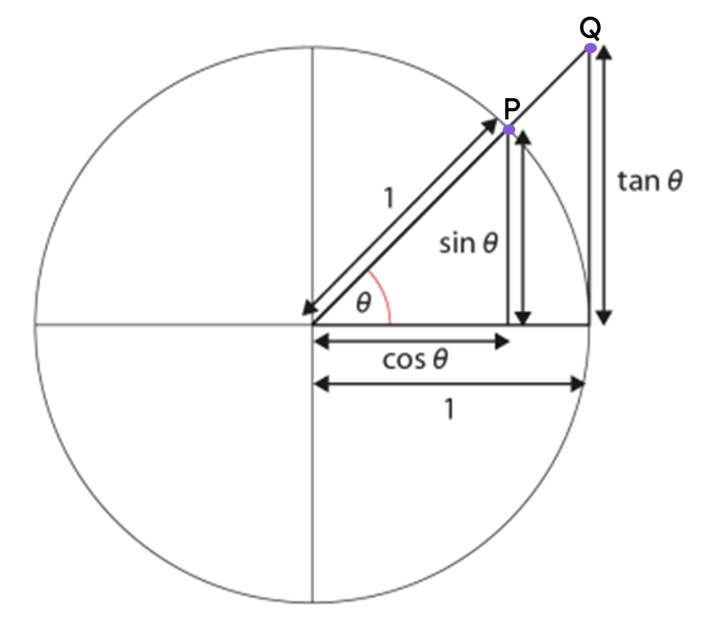
Trigonometric functions are commonly defined as ratios of two sides of a right-angled triangle for a given angle.
The sine of an angle (sin(θ°)) is the y-coordinate of point P on the triangle formed inside the unit circle.
The cosine of an angle (cos(θ°)) is the x-coordinate of point P on the triangle formed inside the unit circle.
A tangent to a circle is a line that intersects the circle exactly once.
The tangent of an angle (tan(θ°)) is the y-coordinate of point Q on the triangle which extends from the unit circle.

Slide 6

The unit circle
Introduction to sine and cosine
Introduction to tangent

Slide 7

Introduction to sine and cosine
How far is the point with coordinates (4, 3) from the origin?
y
x² =
4²
+ 3²
5
4
(4,3)
x² =
25
3
2
x
x =
5 units
1
O
x
-5
-4
-3
-2
-1
1
2
3
4
5
-1
-2
-3
-4
-5

Slide 8
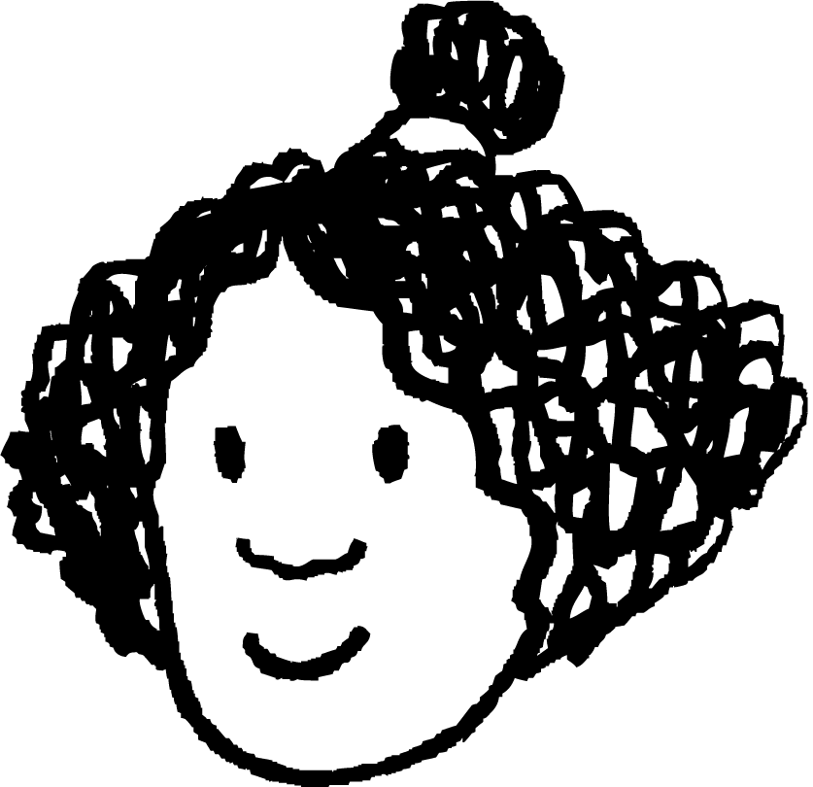

Introduction to sine and cosine
The length of the hypotenuse is 5 units and has a vertex at the origin.
Izzy creates a similar triangle on a coordinate grid with a hypotenuse length of 1 unit. What are the coordinates of point P?
y
y
scale factor =
(4, 3)
P
5
1
of 4 = 0.8
3
0.6
O
O
x
x
4
0.8
of 3 = 0.6
(0.8, 0.6)

Slide 9
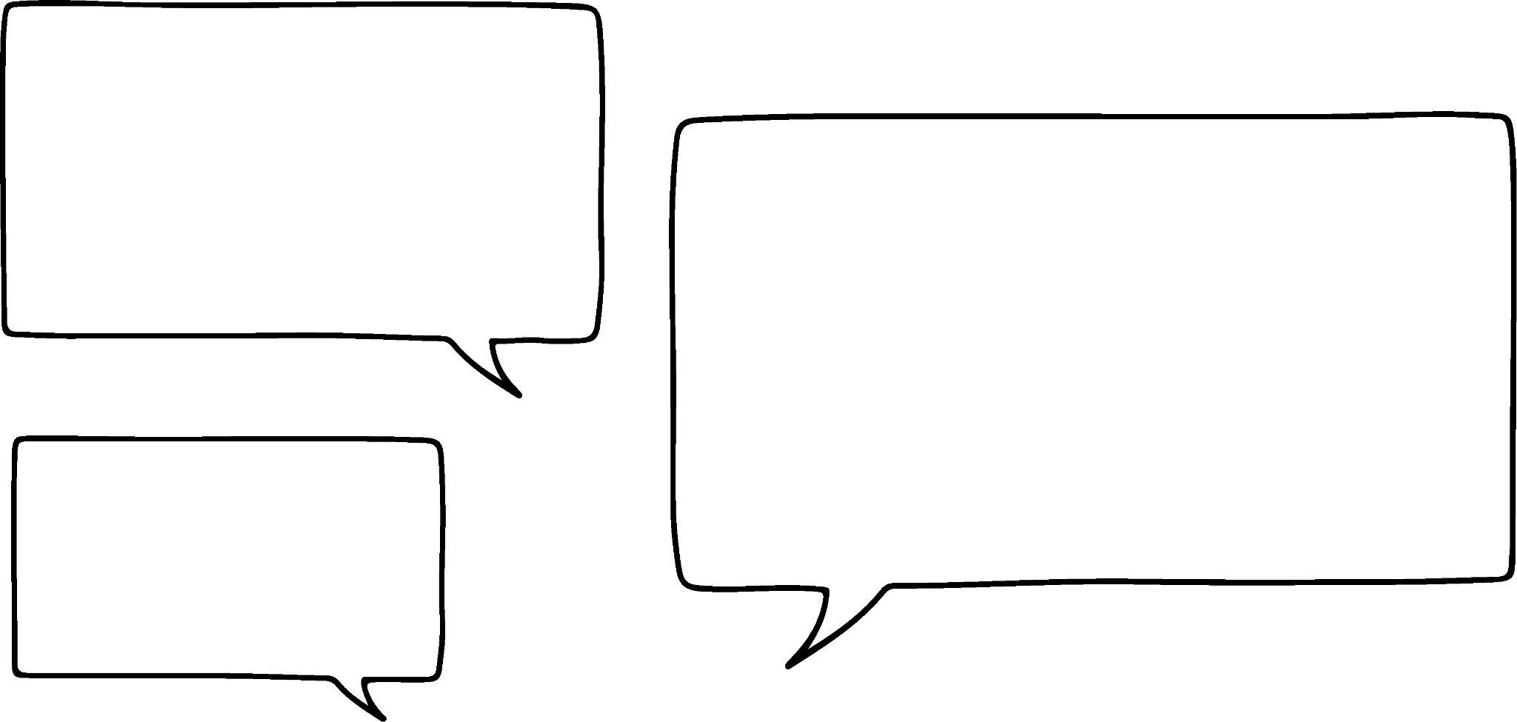

Introduction to sine and cosine
The triangle below has a hypotenuse of length 1 unit with one of its vertices at the origin.
y
Point P would move in a circle around the origin.
What would happen if we kept the hypotenuse at a fixed length of 1 unit and changed the position of point P?
P
1
The radius of the circle would be 1 unit.
O
x
Alex
Izzy
Use the link for an interactive version: triangle with hypotenuse of 1 unit🖇

Slide 10

Introduction to sine and cosine
The unit circle is a circle on a coordinate grid
that is centred at the
origin
and has a radius of 1 unit.
y
1
1
1
1
1
1
x
-1
O
1
1
1
1
-1

Slide 11

Introduction to sine and cosine
A right-angled triangle can be made between the radius and the x-axis.
y
1
The hypotenuse of the triangle is the radius of the circle.
So, the hypotenuse has a length of 1 unit.
1
-1
O
1
x
Lucas
-1

Slide 12
Introduction to sine and cosine
The two other lengths on the triangle can be found from the coordinates of the point where the radius intersects the circle.
y
1
(0.8, 0.6)
The length of the triangle’s horizontal edge can be deduced from the x-coordinate.
1
-1
O
0.8
1
x
0.8
Lucas
-1

Slide 13
Introduction to sine and cosine
The two other lengths on the triangle can be found from the coordinates of the point where the radius intersects the circle.
y
1
(0.8, 0.6)
The length of the triangle’s vertical edge can be deduced from the y-coordinate.
0.6
1
0.6
-1
O
0.8
1
x
0.8
Lucas
-1

Slide 14
Introduction to sine and cosine
As the radius is rotated around the circle, we can consider how the angle of rotation affects the lengths on the triangle.
y
1
(1, 0)
-1
O
1
x
-1

Slide 15
Introduction to sine and cosine
As the radius is rotated around the circle, we can consider how the angle of rotation affects the lengths on the triangle.
y
1
(0.94, 0.34)
1
20°
-1
O
1
x
-1

Slide 16
Introduction to sine and cosine
As the radius is rotated around the circle, we can consider how the angle of rotation affects the lengths on the triangle.
y
1
(0.8, 0.6)
1
37°
-1
O
1
x
-1

Slide 17
Introduction to sine and cosine
As the radius is rotated around the circle, we can consider how the angle of rotation affects the lengths on the triangle.
y
1
(0.4, 0.92)
What changes?
The lengths of the horizontal and vertical edges vary.
1
67°
-1
O
1
x
What stays the same?
The length of the hypotenuse is always 1 unit.
-1

Slide 18
Introduction to sine and cosine
As the radius is rotated around the circle the angle of rotation affects the y-coordinate of the point on the circle.
y
1
The sine of an angle is the y-coordinate of the point where the radius has been rotated through that angle.
0.6
(0.8, 0.6)
37°
-1
O
1
x
E.g. The sine of 37° is 0.6.
Link to interactive version: unit circle (sine and cosine)🖇
-1

Slide 19
Introduction to sine and cosine
As the radius is rotated around the circle, the angle of rotation affects the x-coordinate of the point on the circle.
y
1
The cosine of a given angle is the x-coordinate of the point where the radius has been rotated to form that angle.
(0.94, 0.34)
20°
-1
O
1
x
0.94
E.g. The cosine of 20° is 0.94.
Link to interactive version: unit circle (sine and cosine)🖇
-1

Slide 20
Introduction to sine and cosine
y
1
sine
The of an angle is the y-coordinate of the point where the radius has been rotated through that angle.
52°
-1
O
1
x
-1

Slide 21
Introduction to sine and cosine
y
1
The cosine of an angle is the of the point where the radius has been rotated through that angle.
x-coordinate
52°
-1
O
1
x
-1

Slide 22
Introduction to sine and cosine
The angle can be represented by the Greek letter θ (“theta”).
y
sin(θ)
In the unit circle θ is the angle that the radius is rotated anticlockwise from its starting point at (0, 1).
1
A short way to write “sine of the angle” is sin(θ), where sin means sine and θ is the angle.
θ°
-1
1
x
O
cos(θ)
A short way to write “cosine of the angle” is cos(θ), where cos means cosine and θ is the angle.
-1

Slide 23


Introduction to sine and cosine
Triangles cannot have negative lengths. Therefore, for triangles in a unit circle, sin(θ) only equals the vertical length when its value is positive.
sin(θ)
1
Also, cos(θ) only equals the horizontal length when its value is positive.
II
I
In which quadrants do both sin(θ) and cos(θ) take positive values?
θ°
-1
O
1
cos(θ)
III
IV
The first quadrant only.
-1

Slide 24
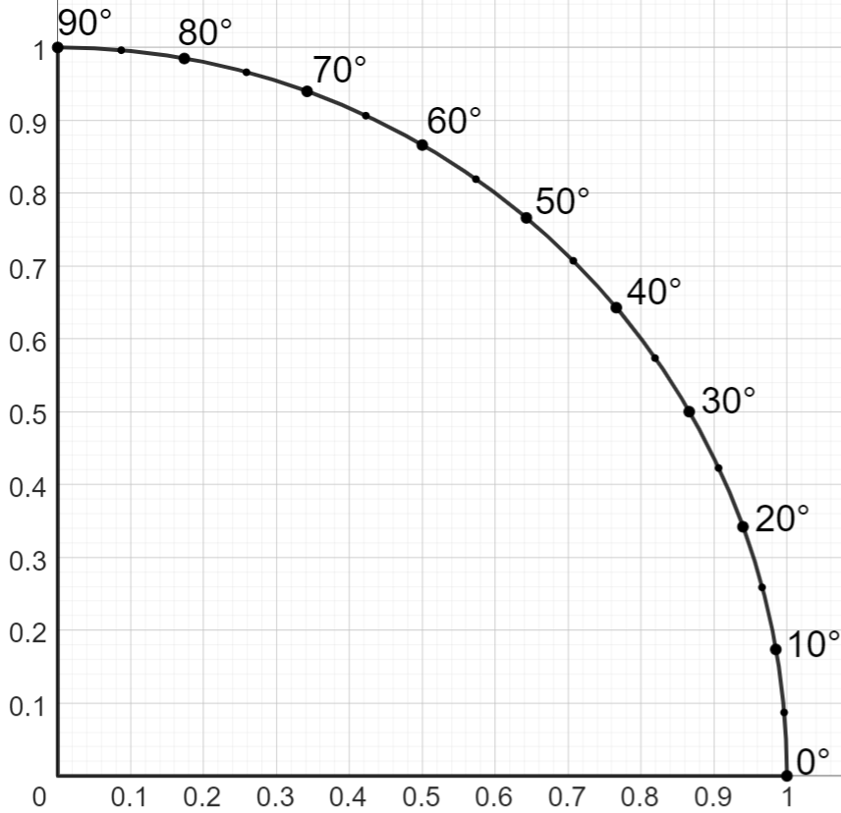
Introduction to sine and cosine
The diagram shows the sector of the unit circle that lies in the first quadrant.
sin(θ)
The points around the circumference show the angle of rotation (θ) from the horizontal axis to the radius at each point.
E.g. θ = 20°
20°
cos(θ)
Link to an interactive version: unit circle in first quadrant🖇

Slide 25
Introduction to sine and cosine
sin(θ)
What is sine of 40°?
0.64
sin(40°) = 0.64
40°
cos(θ)
0.77

Slide 26
Introduction to sine and cosine
sin(θ)
0.91
What is cosine of 65°?
cos(65°) = 0.42
65°
cos(θ)
0.42

Slide 27
Introduction to sine and cosine
1) The diagram shows the sector of the unit circle that lies in the first quadrant.
sin(θ)
a) Use the diagram to complete the table.
θ° | 0 | 10 | 20 | 30 | 40 | 50 | 60 | 70 | 80 | 90
sin(θ)
b) What happens to the value of sin(θ) as the angle increases in this quadrant?
c) Use your table to find the angle where sin(θ) = 0.5.
d) Use the diagram to find the angle where sin(θ) = 0.8.
cos(θ)

Slide 28
Introduction to sine and cosine
2) The diagram shows the sector of the unit circle that lies in the first quadrant.
sin(θ)
a) Use the diagram to complete the table.
θ° | 0 | 10 | 20 | 30 | 40 | 50 | 60 | 70 | 80 | 90
cos(θ)
b) What happens to the value of cos(θ) as the angle increases in this quadrant?
c) Find the angle where cos(θ) = 0.5.
d) Find the value of θ where cos(θ) = sin(40°).
cos(θ)
e) Find the angle where cos(θ) = sin(θ).

Slide 29
Introduction to sine and cosine
1) The diagram shows the sector of the unit circle that lies in the first quadrant.
a) Use the diagram to complete the table.
θ° | 0 | 10 | 20 | 30 | 40 | 50 | 60 | 70 | 80 | 90
sin(θ)
0
0.17
0.34
0.5
0.64
0.77
0.87
0.94
0.98
1
Answers may vary slightly depending on how accurately they are read from the graph.
Use the link for an interactive version: unit circle in first quadrant🖇
b) What happens to the value of sin(θ) as the angle increases in this quadrant?
It increases. Its lowest value is 0 and greatest value is 1.
30°
c) Use your table to find the angle where sin(θ) = 0.5.
d) Use the diagram to find the angle where sin(θ) = 0.8.
53°

Slide 30
Introduction to sine and cosine
2) The diagram shows the sector of the unit circle that lies in the first quadrant.
a) Use the diagram to complete the table.
θ° | 0 | 10 | 20 | 30 | 40 | 50 | 60 | 70 | 80 | 90
cos(θ)
1
0.98
0.94
0.87
0.77
0.64
0.5
0.34
0.17
0
Answers may vary slightly depending on how accurately they are read from the graph.
Use the link for an interactive version: unit circle in first quadrant🖇
b) What happens to the value of cos(θ) as the angle increases in this quadrant?
It decreases. Its lowest value is 0 and greatest value is 1.
60°
c) Find the angle where cos(θ) = 0.5.
d) Find the value of θ where cos(θ) = sin(40°).
50°
e) Find the angle where cos(θ) = sin(θ).
45°

Slide 31
The unit circle
Introduction to sine and cosine
Introduction to tangent

Slide 32
Introduction to tangent
A tangent of a circle is a line that intersects the circle exactly once.
tangents:
tangent
not tangents:

Slide 33
Introduction to tangent
y
The tangent of an angle is the y-coordinate of the point where the line (the triangles hypotenuse) intersects the tangent line.
1
1
45°
-1
O
1
x
E.g. The tangent of 45° is 1.
Link to an interactive version: unit circle (tangent)🖇
-1

Slide 34
Introduction to tangent
y
1
A short way to write “tangent of the angle” is
tan(θ)
1
45°
Abbreviation of tangent
-1
1
Angle of rotation
O
x
E.g. tan(45°) = 1
Link to an interactive version: unit circle (tangent)🖇
-1

Slide 35

Introduction to tangent
Use the interactive version to explore what happens as θ varies
y
1
tan(θ)
I wonder what happens to the value of tan(θ) as the angle changes.
θ
-1
O
1
x
Aisha
Link to an interactive version: unit circle (tangent)🖇
-1

Slide 36
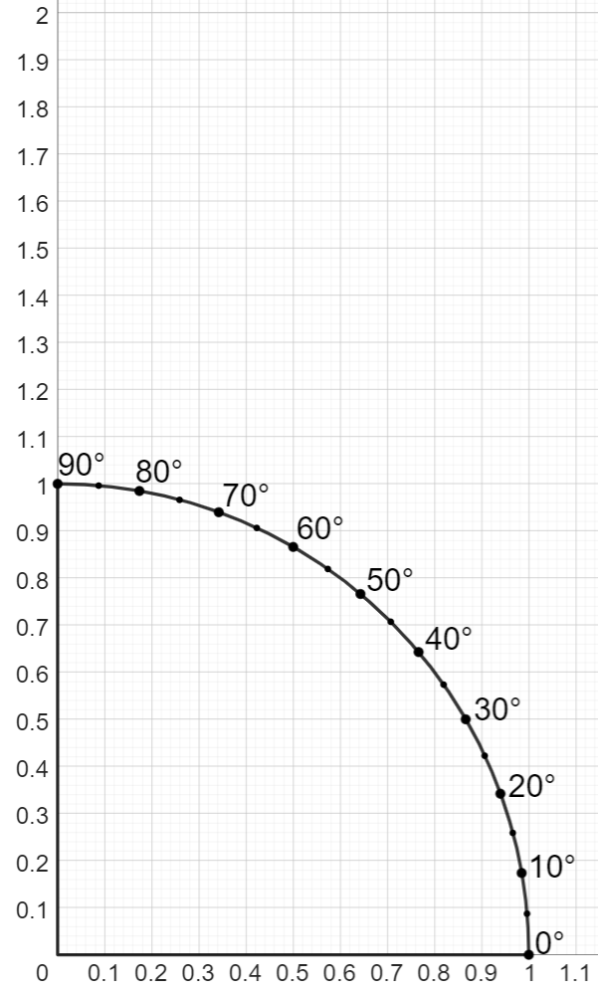
Introduction to tangent
The diagram shows the sector of the unit circle that lies in the first quadrant.
By drawing a tangent at x = 1, we can find the tangent of some angles in the unit circle.
0.84
E.g. tan(40°) =
0.84
Link to an interactive version: unit circle in first quadrant🖇
40°

Slide 37
Introduction to tangent
What is the value of tan(50°)?
1.19
1.19
0.77
0.77
0.64
50°
0.64

Slide 38
Introduction to tangent
What is the value of sin(50°)?
1.19
1.19
0.77
0.77
0.64
50°
0.64

Slide 39
Introduction to tangent
What is the value of cos(50°)?
1.19
1.19
0.77
0.77
0.64
50°
0.64

Slide 40
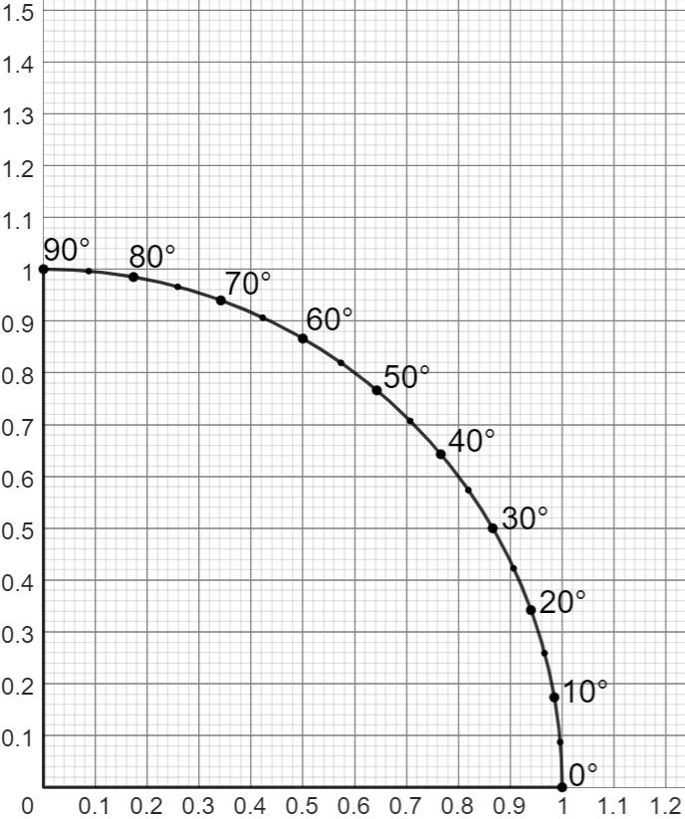
Introduction to tangent
1) The diagram shows the first quadrant of the unit circle.
a) Draw a tangent at x = 1.
b) Find the value of tan(35°)
c) Find the value of tan(55°)
d) Use the diagram to find the angle where tan(θ) = 1.
e) Use the diagram to find the angle where tan(θ) = 0.5.
For an interactive version of the diagram, click the link: unit circle in first quadrant🖇

Slide 41
Introduction to tangent
2) a) Complete the table.
θ° | 30 | 40 | 50
sin(θ)
cos(θ)
tan(θ)
b) For each angle, divide the value of sin(θ) by the value of cos(θ). What do you notice?
For an interactive version of the diagram, click the link: unit circle in first quadrant🖇

Slide 42
Introduction to tangent
1) The diagram shows the first quadrant of the unit circle.
a) Draw a tangent at x = 1.
b) Find the value of tan(35°)
0.7
c) Find the value of tan(55°)
1.4
d) Use the diagram to find the angle where tan(θ) = 1.
45°
e) Use the diagram to find the angle where tan(θ) = 0.5.
27°
Answers may vary slightly depending on how accurately they are read from the graph.

Slide 43
Introduction to tangent
2) a) Complete the table.
θ° | 30 | 40 | 50
sin(θ)
cos(θ)
tan(θ)
0.5
0.64
0.77
0.87
0.77
0.64
0.58
0.84
1.19
Answers may vary depending on accuracy.
b) For each angle, divide the value of sin(θ) by the value of cos(θ). What do you notice?
The result of each division is approximately equal to the value of tan(θ).

Slide 44
The unit circle
The unit circle is a circle with a radius of 1 unit.
The unit circle is centered on the origin.
The sine of an angle is the y-coordinate of the point where the radius has been rotated through that angle.
The cosine of an angle is the x-coordinate of the point where the radius has been rotated through that angle.
The tangent (function) of an angle is the y-coordinate of the point where the extended radius intersects with the tangent (line) to the unit circle (x = 1).

Slide 45

© Oak National Academy 2024.
Produced in partnership with Mathematics in Education and Industry.
Licensed on the Open Government Licence v3.0, except where otherwise stated. See Oak terms and conditions.

